Slide 1
Project Presentation of Ptoject
On
CulinaryCrafts : A Food App
Submitted By:
Ishaan Singla (2210992582)
Sanya Bajaj (2210992255)
Ishneet (2210991681)
Submitted To:
Dr. Preeti Saini
Department of Computer Science and Engineering,
Chitkara University, Punjab

Slide 2

Introduction
CulinaryCrafts is a MERN-stack web application designed as an all-in-one food companion. It enables users to:
  Browse and discover recipes
  Generate custom recipes using Google Gemini AI.
  Connect with food enthusiasts via real-time chat (Socket.IO).
  Shop for ingredients and manage personal shopping lists
  The platform combines modern web technologies with AI to deliver a fun, interactive, and practical cooking experience.

Slide 3
PROBLEM STATEMENT
Cooking enthusiasts often face challenges such as:
  Difficulty in finding personalized recipes that match dietary preferences.
  Lack of real-time interaction with other food lovers.
  Managing ingredient shopping lists efficiently.
  Limited platforms that combine recipe discovery, AI assistance, and social engagement in one place.
  Goal:
  To develop a comprehensive food application that solves these issues by integrating AI-powered recipe generation, real-time chat, and ingredient management in a single platform.

Slide 4
Technology Stack
Frontend: React.js for dynamic UI and responsive design
Backend: Node.js with Express.js for RESTful APIs
Database: MongoDB Atlas for flexible NoSQL storage
Real-Time Communication: Socket.IO for instant messaging and image sharing
AI Integration: Google Gemini API for personalized recipe generation

Slide 5
Architecture
Client-Server Model: React.js frontend communicates with Node.js backend via RESTful APIs.
Authentication Layer: JWT-based authentication for secure user sessions.
State Management: Context API for global state (user, cart, chat).
Database Layer: MongoDB Atlas for storing users, recipes, chat messages, and shopping lists.
Real-Time Communication: Socket.IO for bidirectional messaging and image sharing.
AI Integration Layer: Gemini API for generating structured recipes based on user prompts.

Slide 6
System Design
FRONTEND
(React.js)
BACKEND
(Express.js)
DATABASE
(MongoDB)
-- UI interaction
-- Handle requests
-- Store/retrieve user/recipes/Ingredients
-- State Management
-- API Routes
-- Axios Requests
-- Middleware (JWT)
(Data Handling)
(Backend: Process requests, Data Validation, Auth)
(User Actions: explore recipes, order Ingredients, chat)

Slide 7
Key Features Implemented
AI-Powered Recipe Generation: Users input custom requests; Gemini API returns structured recipes instantly.
Real-Time Chat with Image Sharing: Socket.IO enables instant messaging and image uploads in community chat.
Shopping List & Cart Management: Add/remove ingredients, persistent storage using MongoDB and LocalStorage.
Recipe Browsing & Saving: Browse curated recipes and save AI-generated ones for future use.
User Authentication: Secure login/signup with JWT and hashed passwords.
Persistent Chat History: Messages stored locally for quick reload and MongoDB for long-term storage.

Slide 8
Challenges & Solution
Challenge 1: Managing Real-Time Data with HTTP
Solution: Efficiently handling real-time data through regular HTTP requests, pushing updates to MongoDB.
Challenge 2: Secure Data Storage and Management
Solution: Using bcrypt for encryption and Mongoose for effective database management.
Challenge 3: Scalability and Performance
Solution: Optimizing code, employing efficient data handling practices, and ensuring the system can handle increasing loads.
Challenge 4: Ensuring Data Integrity
Solution: Use backend validation and Mongoose schema validation to ensure correct data formatting and prevent corruption.

Slide 9
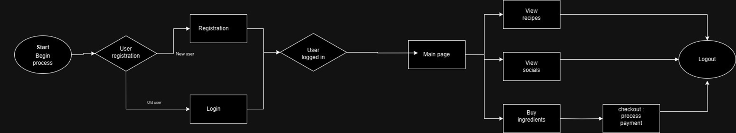
work flow
.
  Explanation:
    Start/Begin Process: Entry point for the application.
    User Registration: Decision point for new or returning users. New users go through Registration, and existing users proceed to Login.
    Main Page: After logging in, users reach the main page with options to:
      View Recipes
      View Socials (Chat)
      Buy Ingredients (which leads to Checkout/Process Payment)
    All paths eventually lead to Logout.

Slide 10
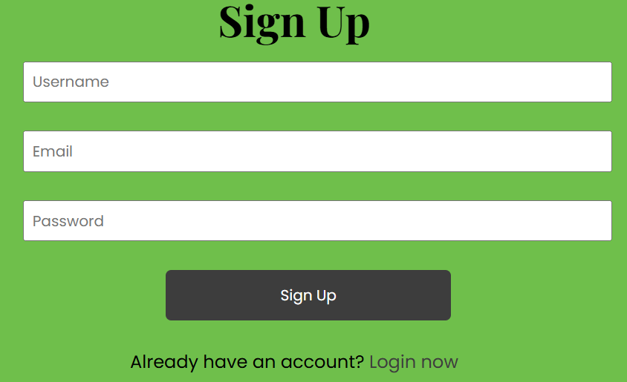
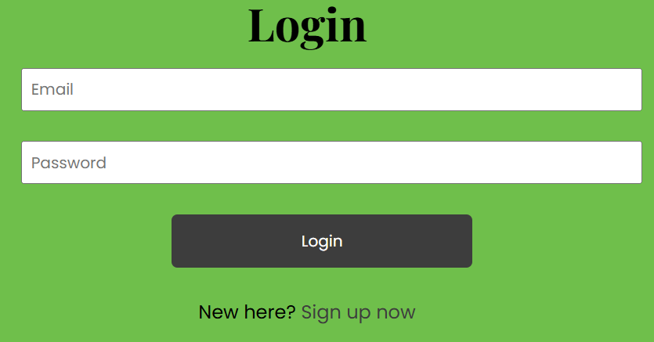
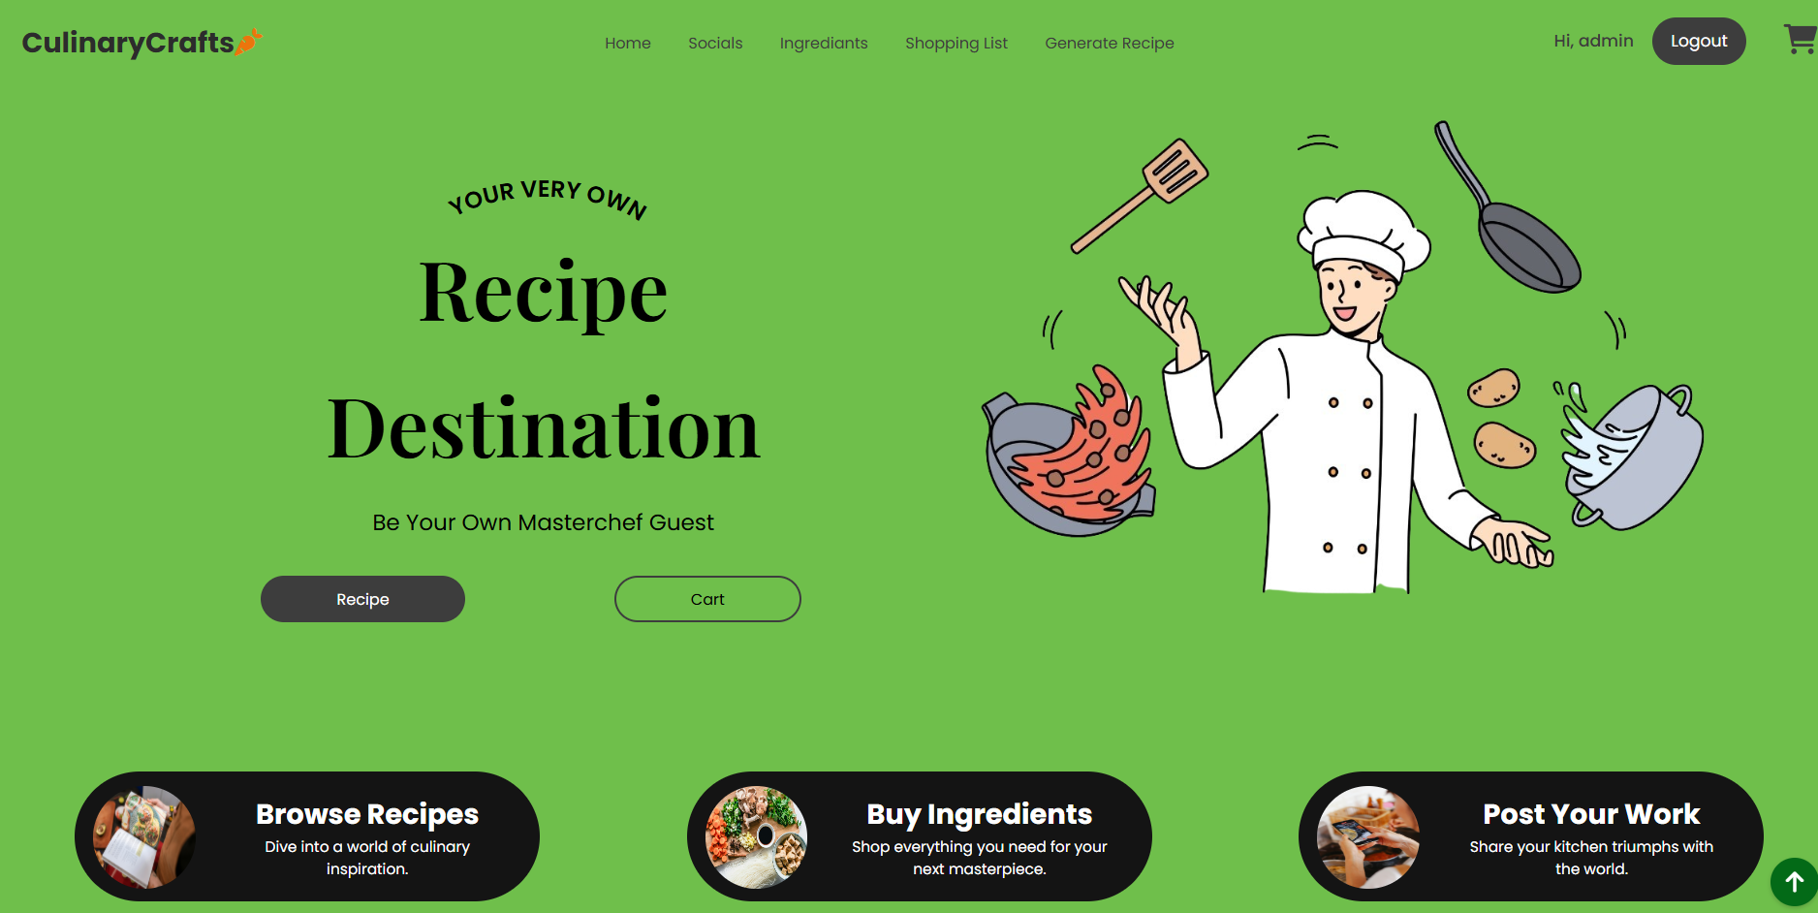
Screenshots

Slide 11
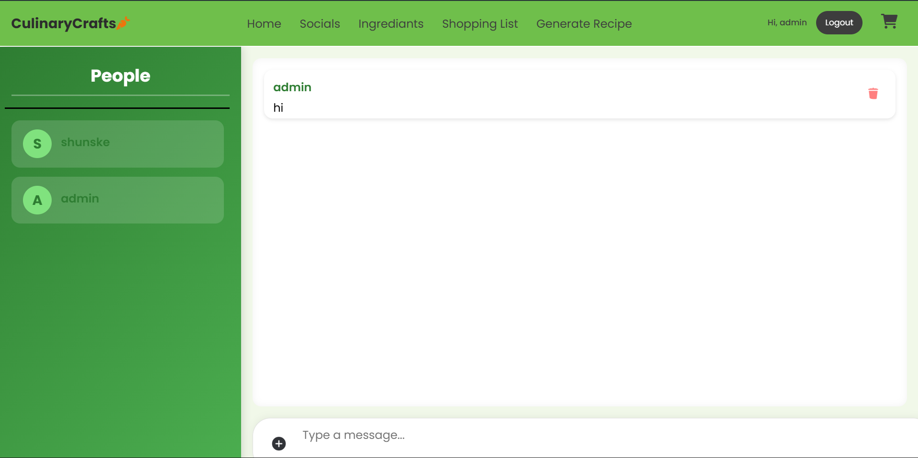
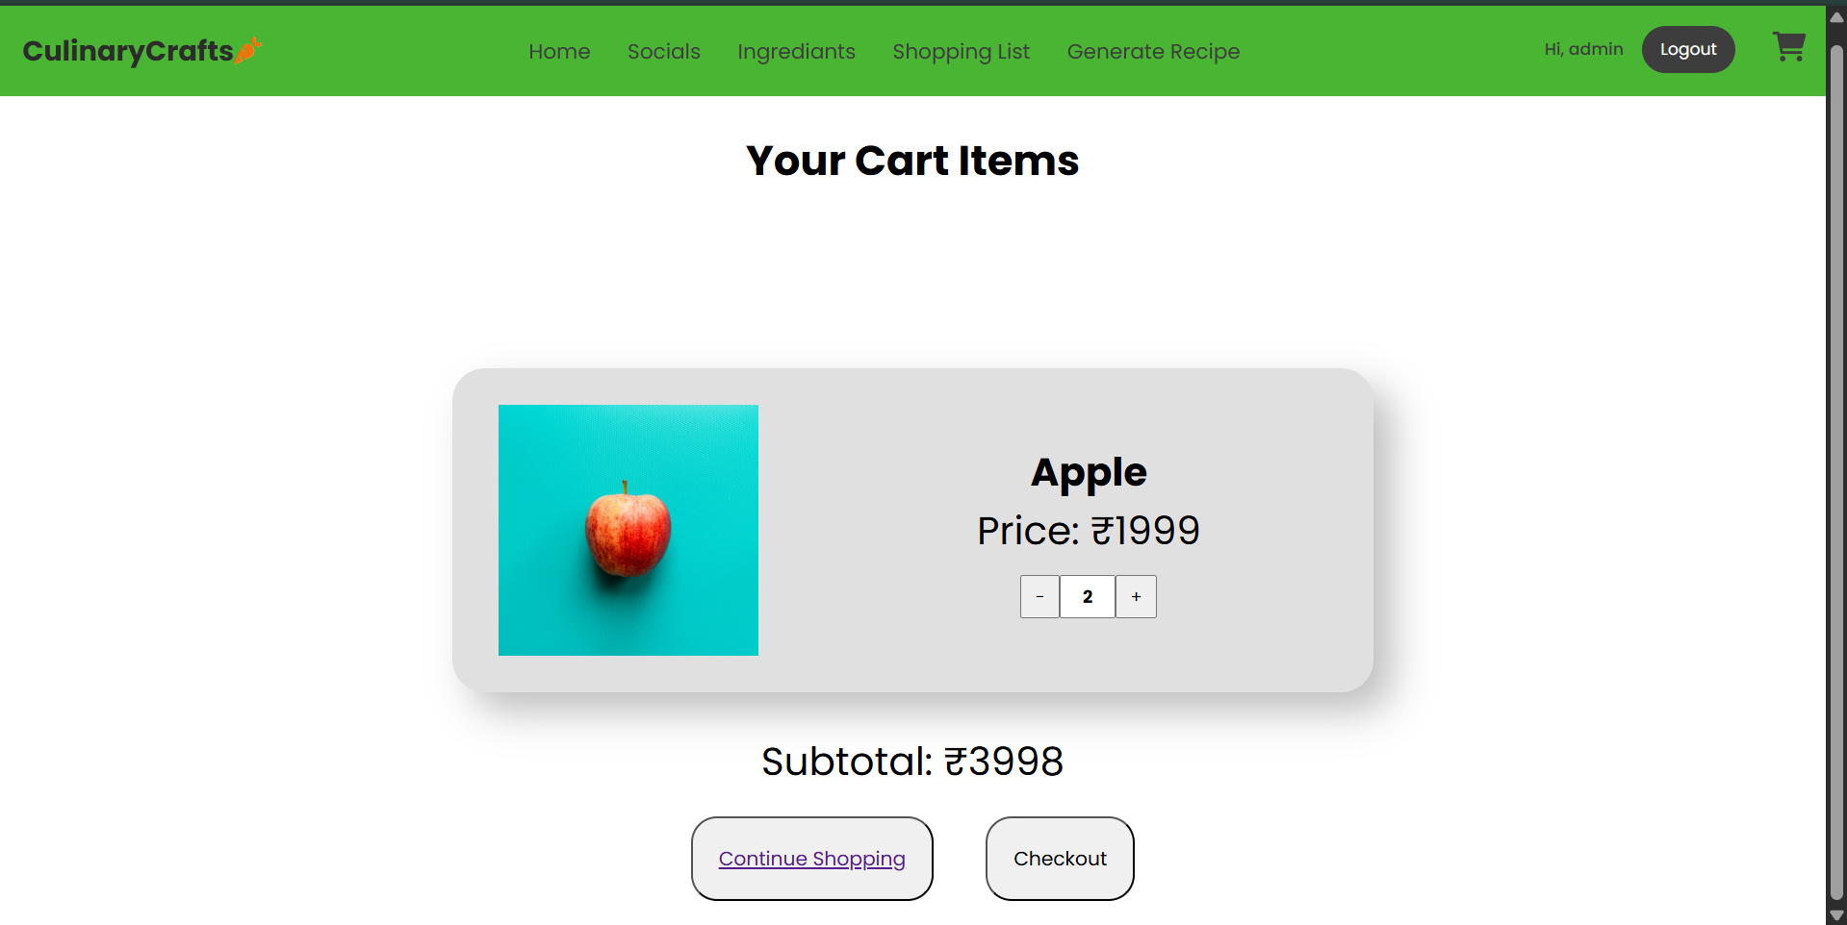

Slide 12
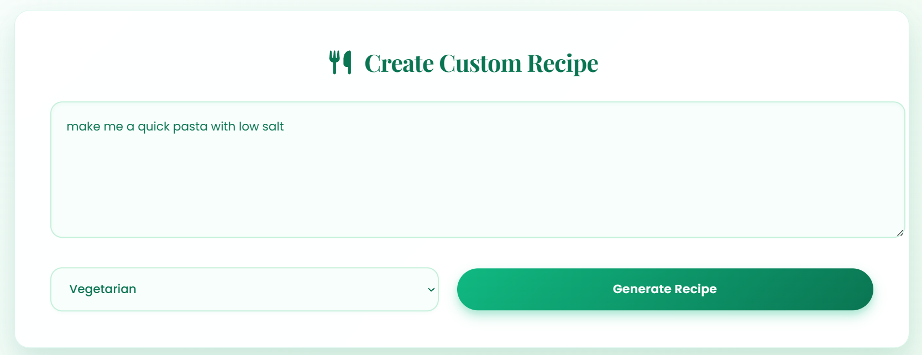
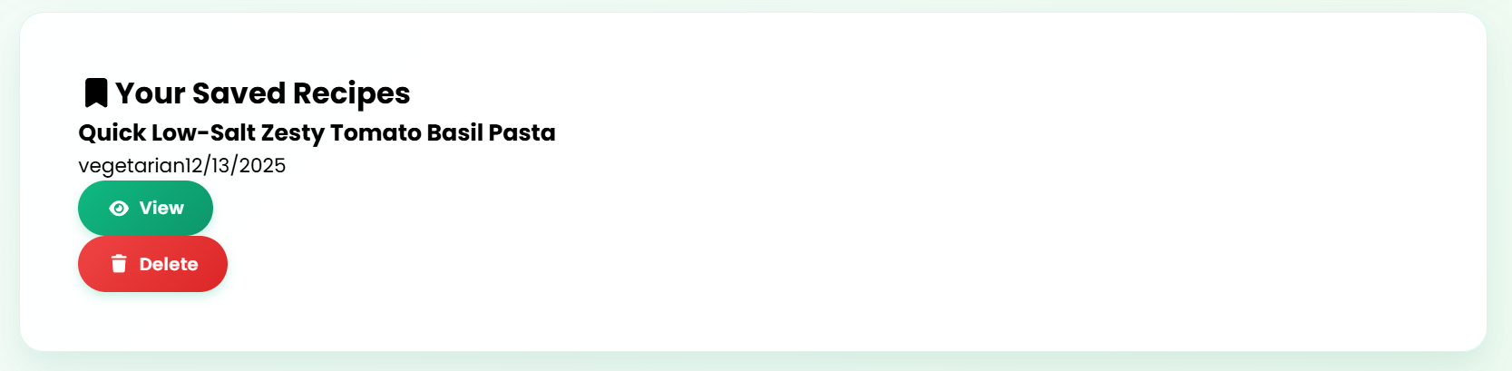

Slide 13
CONCLUSION
CulinaryCrafts successfully integrates recipe discovery, AI-powered recipe generation, real-time social interaction, and ingredient management into a single platform.
The project demonstrates:
  Effective use of MERN stack for full-stack development.
  Seamless integration of Google Gemini AI for personalized recipes.
  Real-time communication using Socket.IO.
The application is responsive, scalable, and user-friendly, meeting the initial objectives.
It provides a modern solution for cooking enthusiasts by combining technology and convenience.
13

Slide 14
REFERENCE
Gemini API : https://ai.google.dev/gemini-api/docs
reactJS : https://react.dev/learn
MongoDB : https://www.mongodb.com/docs/
SocketIO : https://socket.io/docs/v4
JWT : https://developers.docusign.com/platform/auth/jwt/
Mongoose : https://mongoosejs.com/docs/
expressJS : https://expressjs.com/
NodeJS : https://nodejs.org/api/all.html
14

Slide 15
Thank You
15

